Slide 1
Automatic Railway Ticketing
Software Development
Inter IIT Tech Fest

Slide 2

Team IIT Madras
Members:
Vineet Upadhyay
R Santhosh Kumar

Slide 3

Long queues at ticketing counters

Slide 4
Modern Day Ticketing
Long Queues at Counters
Large dependency of people on Railways
Limited no. of counters
Each counter can provide only one person a time
Slow ticket processing
Order ticket
Pull out change from your pocket
Take the printout

Slide 5
Proposed Solution
Replace every ticket counter with a Wi-Fi enabled computer [Server]
The Server runs a specific ticket vending software [Server Software]
People are provided with an IOS/Android application [Client App]
The Client App can connect to the Server over a local Wi-Fi network and request tickets
Payment process happens through online P2P currency transfer [Bitcoin]

Slide 6
Online Currency - Bitcoin
Bitcoin – virtual electronic currency, easy to transfer
Just like your physical wallet – bitcoin wallet
A bitcoin wallet is an app or software installed on your mobile or pc
No hassles of handling cash
No or minimal transaction fee
Instantaneous P2P transfer

Slide 7
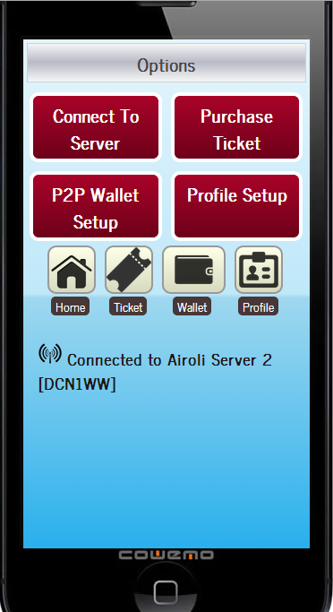
Ticket Purchase Application Home Page
Launch Application
Go to Profile Setup

Slide 8
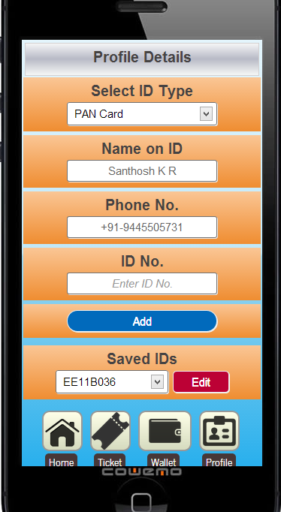
Application Setup: Step 1
Configure Personal Details (One time only)
Next, Go to Home > P2P Wallet

Slide 9
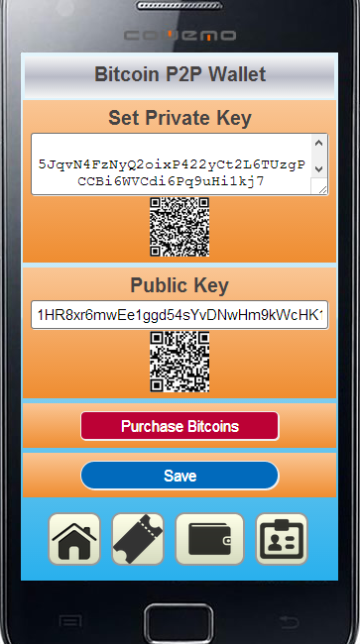
Application Setup: Step 2
Configure Your Wallet (One time only)
Import your private key (to make payments from)
Import your public key (to receive payments….just in case)
Now you’re ready

Slide 10
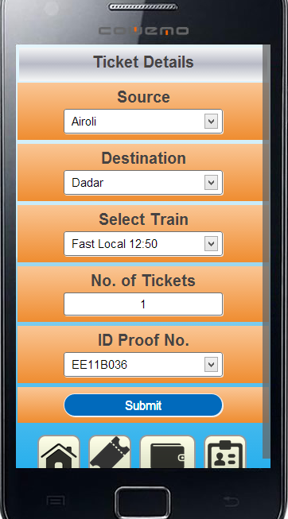
Ticket Purchase Process: Step 1
Go to Home > Purchase Ticket
Select destination
Select Train & Time
Select no of tickets
Select the ID Type
Submit request

Slide 11
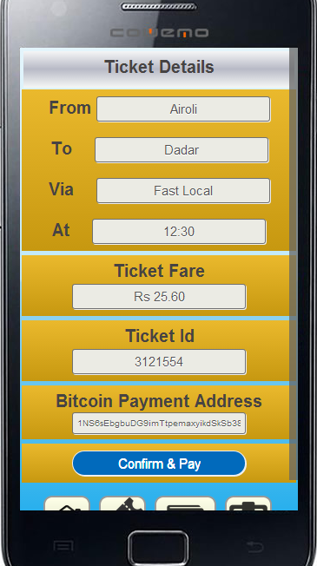
Ticket Purchase Process: Step 2
After request is submitted the Client App retrieves payment url from the server
Confirm you details and pay

Slide 12
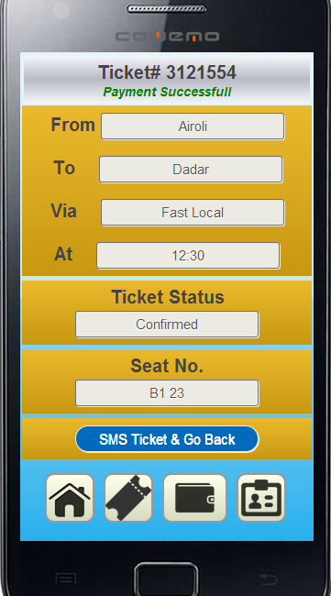
Ticket Purchase Process: Final Step
On successful payment you get a confirmed ticket status with other details
Click the button to receive a SMS Ticket and go back to home page

Slide 13
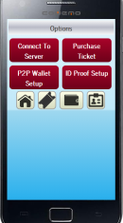





The Flow Chart
Ticket Details
Payment
Ticket Request
Confirmation
Payment
Instructions
SMS Ticket
Users

Slide 14
Pros & Cons
Pros
No manual ticketing
No queues
Fast
No printing tickets
Lesser manpower required
Cons
New system, not widely popular
RBI yet to frame regulatory laws for bitcoin banking

Slide 15
Alternative to Bitcoin?
Future of Bitcoin is uncertain in India
Meanwhile NEFT (National Electronic Funds Transfer) can very well take the place of Bitcoin
They’re not as efficient as Bitcoin due to
Login and security issues as it directly links to your bank account and not to your wallet
Slow and not accepted worldwide
But still can serve as a good alternative because of the recent advancements in mobile banking

Slide 16
Thank You
Questions?

